Slide 1
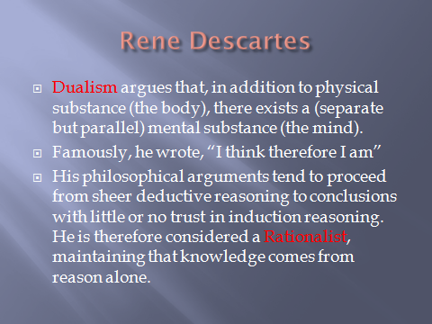

Slide 2
Rationalism
The value of certainty.
  Foundationalists suppose that true beliefs held with certainty (indubitable) together with logical and linguistic analysis offer grounds for other less certain beliefs.
Impediments to certainty.
  What can be doubted will be doubted.
Thought experiments.

Slide 3
The Cogito
“I think, therefore I am”
“Cogito ergo sum” Is held by Descartes to be a clear and distinct idea that is beyond all possible doubt.
But, does the proposition “I exist” really follow simply from “I think”?
Consider the following statement of the same form: I think, therefore potatoes snore.
Obviously, “potatoes snore” does not follow from
“I think.”

Slide 4
What’s gone wrong
If Descartes can on the basis of only deductive reason go from I think back to reconstructing the entire world as he knew it, Why didn’t he say I think therefore potatoes snore.

Slide 5
What’s gone wrong
Descartes did not present his arguments in what we would call syllogistic form.
Rather, he wove the argument threads through out his essay.
To do justice to Descartes insights, we will have to hunt down the missing elements in his argument.

Slide 6
Conceivability and Divisibility
Commentators find two sorts of arguments:
  Conceivability arguments
    These arguments rely on thought experiments and
    assert that there is a special or model relationship between certain psychological claims (conceiving, imagining, etc.) and certain ontological claims (claims about what may be possible/impossible in fact)
  Divisibility arguments
    These argument are both model and merelogical
    They rely upon our notions of part whole relations and standards of logic.

Slide 7
The Divisibility Argument
  Assume:
  Everything is identical to itself.
  Nothing can both have and fail to have it’s essential properties.
  Each thing cannot fail to have each and every of it’s essential properties.
  No mind takes up space – it is un-extended.
  Nothing un-extended can be divided
  Bodies take up space.
  Bodies can be divided.
  Only spacial things can be divided.
  Indiscernibility: For any pair of things with all the exact same properties they are identical.
9. applies to all property pairs for Minds and bodies
if the identity of mind = body holds.
To prove the non identity we Suppose, 9
  Whatever is true of bodies is true of minds
  Whatever is true of minds is true of bodies.
But,
  Bodies are divisible without loosing essence. 6, 7
  Minds are indivisible. 4, 5
So, 9 fails to obtain. 2, 3
Therefore: Minds are not bodies.

Slide 8
Conceivability argument
Whatever is conceivable is possible.
It is conceivable for me to exist without having a body.
Therefore, it’s possible for me to exist without having a body.
If it’s possible for me to exist without having a body, then having a body is not essential to me..
Therefore, having a body is not essential to me.
It’s inconceivable for me to exist without having a mind.
Therefore, it’s impossible for me to exist and not have a mind.
If it’s impossible for me to exist without having a mind, then having a mind is essential to me.
Therefore, having a mind is essential to me.

Slide 9
Exegesis Task
Find quotes in the text for each element of these arguments.
Present as per your model of evaluative essay outline.

Slide 10
Hello ? Is there anybody out there ?
Descartes sees that his radical doubt together with his analysis of the cogito leaves something very important out of the picture…. Namely everything but Descartes himself.
To short-circuit the doubt he requires a kindly god and the magical ability to know as well as god what is good for man in the way of knowledge.
Even if we accept this we are still a long way from certainty that “potatoes snore.” is false.

Slide 11
How to reclaim the world.
Other properties of mind (not derived from the world nor attributable to the evil genius, thank god) on which to discover the world include:
  The idea of imperfect selfhood
    If I can doubt I must be imperfect.
  The idea of sameness
  The idea of substance or thingness,
    e.g., though wax changes form under heat or pressure it’s still wax.
  Sensory qualia such as sound, color, taste, warmth, etc. are asserted to be mental properties.
      It’s a separate step to get from raw sensation to stuff of the world.
  The idea of perfection,
    If imperfection makes sense then so does perfection. From which he deduces a good god.
    If god is good then no evil genius. So, math is possible.
    If math is possible then so are laws of physics.

Slide 12
So….. What about
“potatoes snore.”

